Slide 1
Salary Predictions of Data Science Roles

Slide 2
Why Data Science Salaries?
We selected this topic because it was one that was of interest to all of us including our classmates. As we graduate from this course and enter the job market we have a frame of reference when negotiating offers.
Our goal throughout this analysis was to better educate us on the salary levels of different data-related jobs.
We wanted to see how factors such as company, location and experience affect the expected salary.

Slide 3
Our Data
The dataset we selected to use is:
Kaggle: Salary and more-Data Scientist, Analyst, Engineer, Retrieved 3/16/2022 from https://www.kaggle.com/jackogozaly/data-science-and-stem-salaries.
Some of the data this dataset includes are job title, salary, company, years of experience, gender, education level and location
During our analysis, we hoped this dataset would help us answer the question of how do different factors such as location, years of experience, gender, and company affect the anticipated salary?
Limitations to Dataset
Accuracy of the data because it was self-reported by humans
Data did not include job descriptions, and all jobs were the same title
There were several imbalances in the dataset such as company size, location, years of experience
Total Yearly Compensation means different things to different people when self reporting (are stock options included, benefit packages, etc)

Slide 4
Exploration of Data
Imported data in csv form into a Jupyter notebook and cleaned the data using pandas:
Dropping columns in Data Frame, such as race, bonus, stock, other details, tag
Remove outlier
Split the location into States, Cities and Countries
Use Drop Na function to remove the empty columns
Bin Companies, years of experience, states and by data count size
OneHotEncoder all the object column
Description of Database component
Connected local Postgres to AWS server using pgAdmin with pyspark in Google colab.

Slide 5
Machine Learning Model Selection
Once the data was clean we did visualizations of the data to decide which models may lend itself better to the data
We initially decided upon a linear model because what we were trying to find was a correlation rather than a classification
Once we tired to linear regression model we decided to explore and build upon it with the Random Forest Regressor
To see if we could improve the model and employ skills learned in class we also tested with a Neural Network

Slide 6
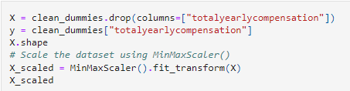
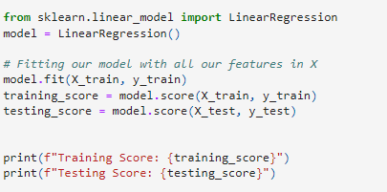
Analysis of Data – Using Linear Regression Machine Learning Model
How was data split into training and testing sets:
We used both the default settings (75/25) and 80/20
Explanation of our model choice
Benefits: Find the relationship between variables (Total Annual Salary vs other factors), to construct a linear equation to the observed data.
Limitations: Some features of the dataset may not be linear correlated with the Salary

Slide 7
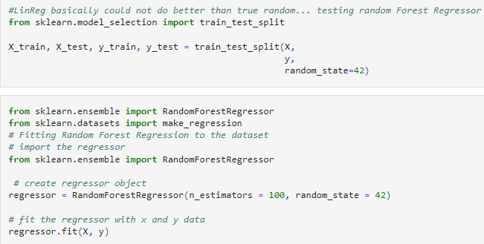
Analysis of Data – Using Random Forest Regressor Machine Learning Model
How was data split into training and testing sets
Explanation of our model choice
Benefits: can solve both regression and classification problems.
This model didn’t require scaling the data
Limitations: The ability to explain this model to stakeholders is a bit more “black box” than the Linear Regression

Slide 8
Analysis of Data– Using Neural Network Machine Learning Model
How was data split into training and testing sets:
We used the standard train test split
Explanation of our model choice
Benefits:
It is a more sophisticated model, however our amount of data did not really lend itself to this type of model
Limitations:
The amount of data we had, the model would perform better with more data

Slide 9
Interactive Dashboard
We will create a website that displays our findings
The tools that will be used to create our dashboard are:
Tools we will use:
Bootstrap
Html
Github Pages to host
Tableau to create interactive visuals for the user

Slide 10
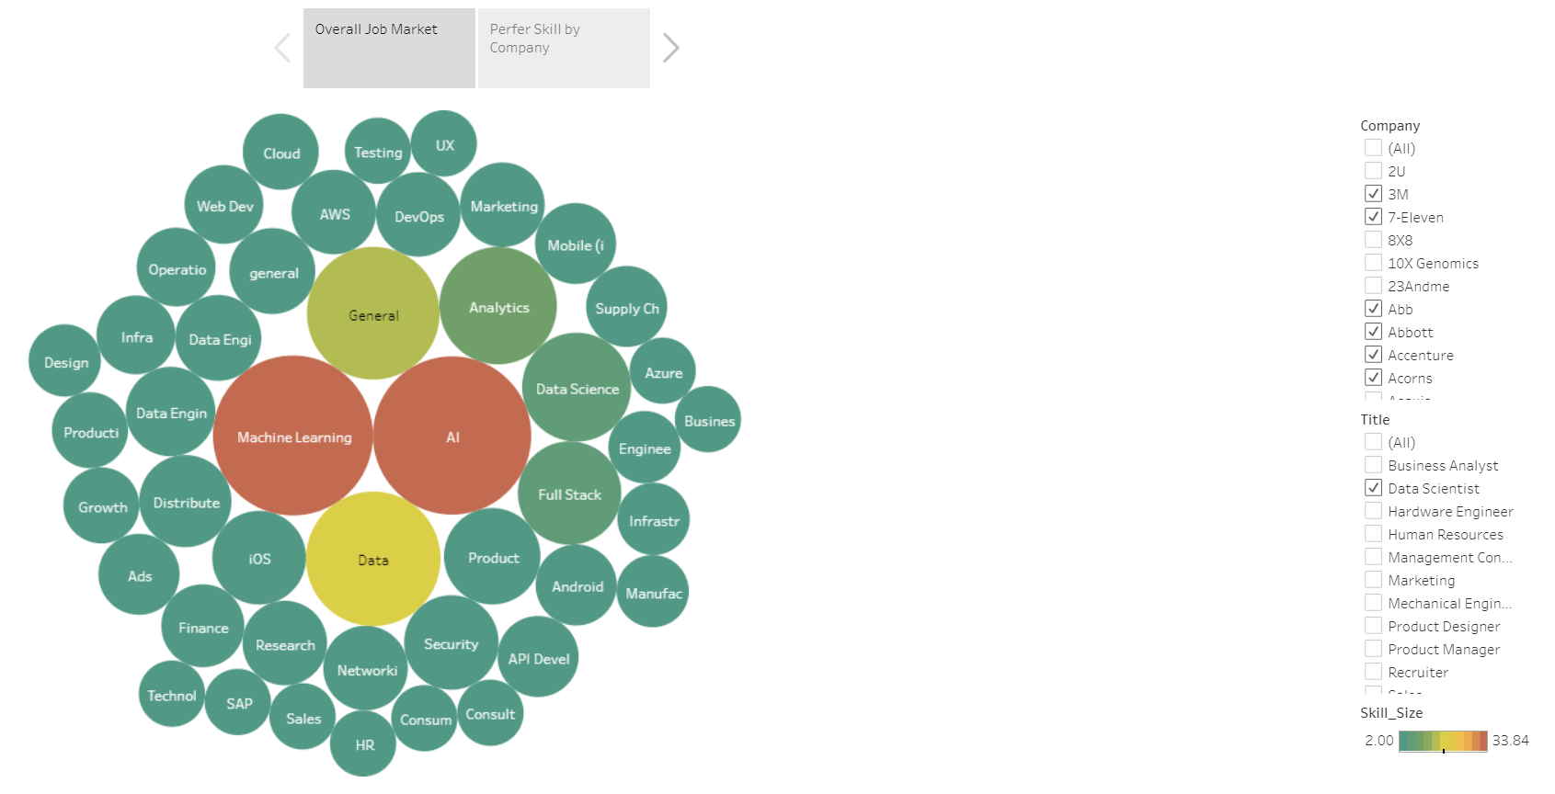
Storyboard: Prefer Skills amount market and different companies
User can filter the titles and companies to see what skills are required or highly acquire by the current employees.
https://public.tableau.com/app/profile/sirius.liao/viz/Preferskillsfordatascientist/Story1

Slide 11
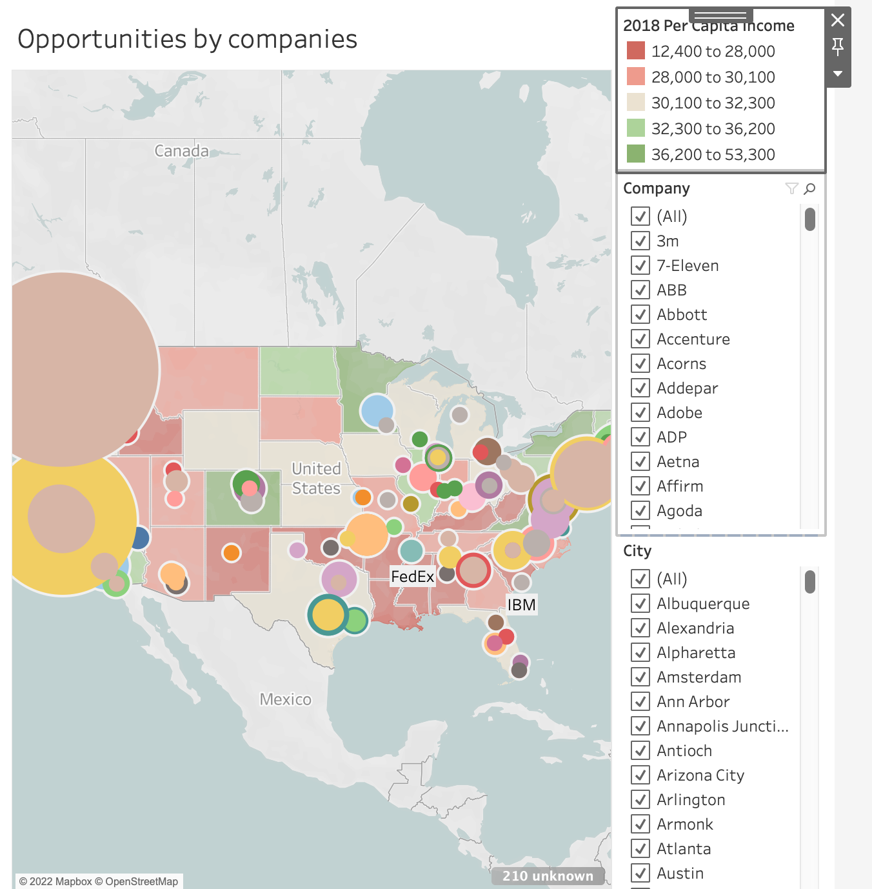
Storyboard: External factors that affect the average salary
Image here
We will have a Tableau dashboard that is interactive for the user. They can filter on company name and city. It will show the number of reported data science employees for that company.
There is also a layer added to the map that has the per capita income of the state reported by Tableau.
https://public.tableau.com/app/profile/mackenzie.coushay.richter/viz/SalaryAnalysis-Summary_16482343926450/location_dashboard?publish=yes

Slide 12


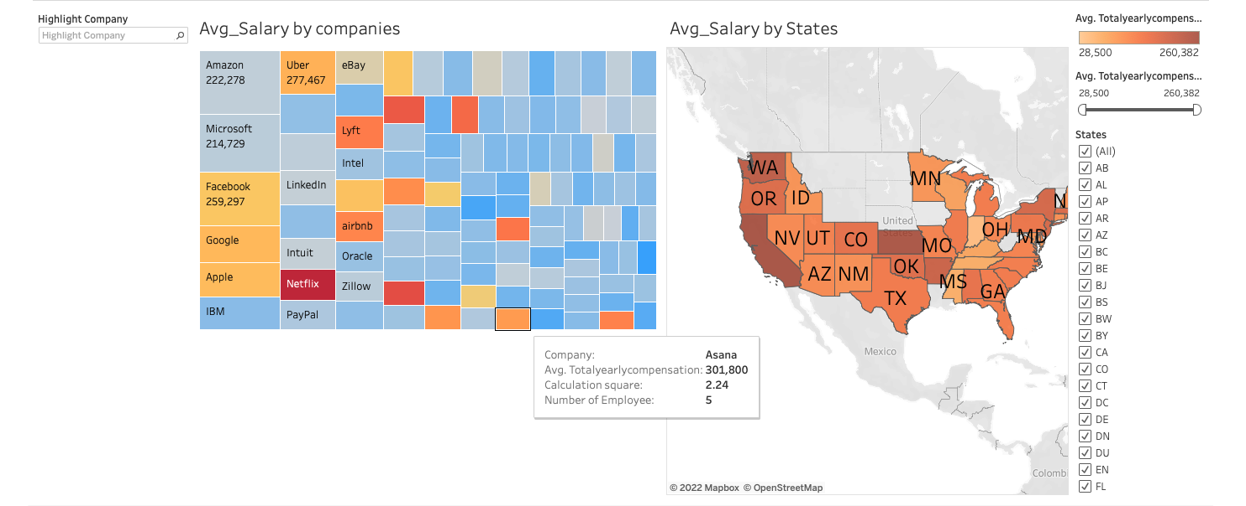

Storyboard: Salary by company and state
z
https://public.tableau.com/app/profile/mackenzie.coushay.richter/viz/SalaryAnalysis-Summary_16482343926450/AverageSalarybyLocationCompany?publish=yes
This Interactive Tableau Dashboard visual will show the average salary by company. It is interactive for the user because they can highlight the company they want to see either type in the company name or select from a dropdown
This Interactive Tableau Dashboard will show the average salary by state. It is interactive for the user because they can filter by both state and desired average Salary.

Slide 13
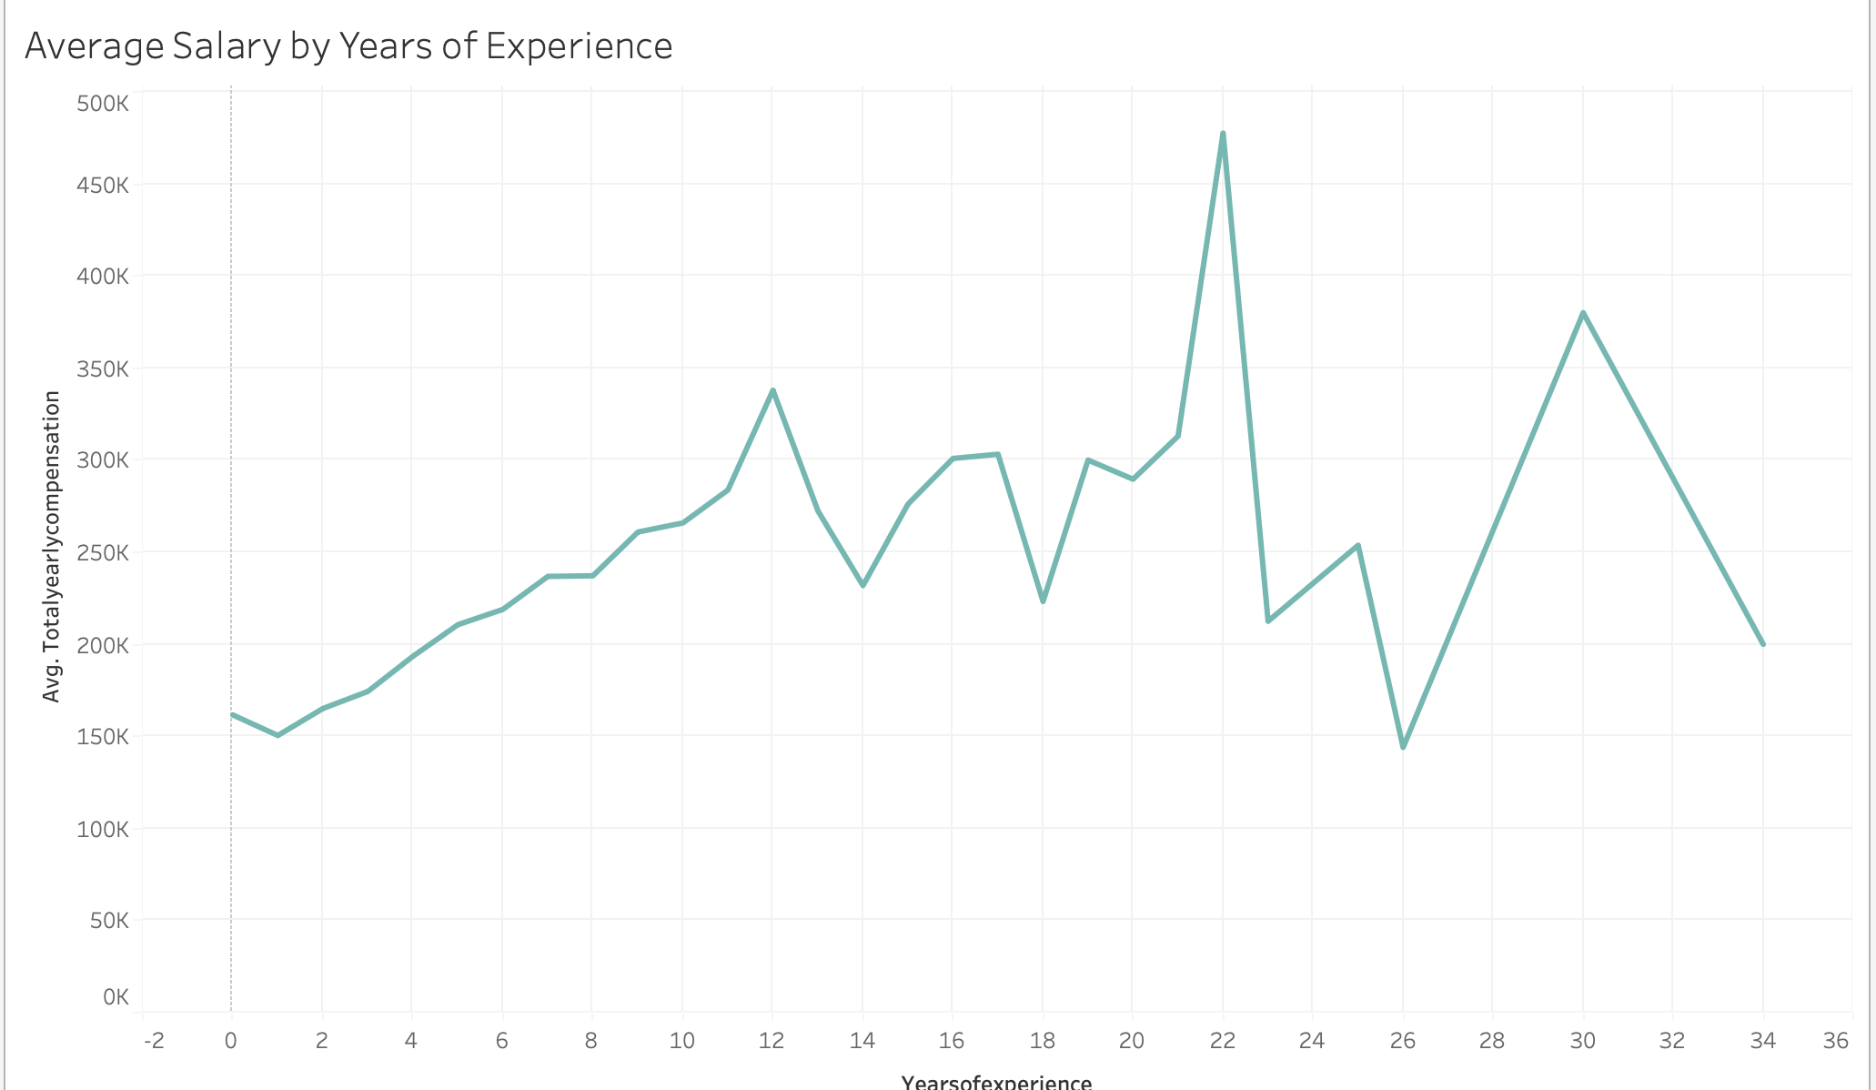
This visual created with Tableau shows average salary by Years of experience collected from our dataset
Storyboard: Average Salary By Years of Experience
https://public.tableau.com/app/profile/mackenzie.coushay.richter/viz/SalaryAnalysis-Summary_16482343926450/Salarybyexp_years?publish=yes

